Slide 1



Quelling an Internal Civil War: New and Emerging Treatments for Graft-vs-Host Disease
The CME credit for this educational activity is provided by The University of Nebraska Medical Center, Center for Continuing Education.
This activity is supported by independent educational grants from Incyte, Jazz Pharmaceuticals, Pharmacyclics LLC, an AbbVie Company, and Janssen Biotech Inc, administered by Janssen Scientific Affairs LLC.

Slide 2
About These Slides
Please feel free to use and/or modify these slides in your noncommercial educational efforts.
When using these slides, please retain the source attribution:
  Slide credit:
The University of Nebraska Medical Center, Center for Continuing Education and Integrity Continuing Education, Inc. (ICE) has designated this enduring material for a maximum of 1.0 AMA PRA Category 1 Credit(s)TM. However, use of these slides outside of the ICE or freeCME websites does not provide this credit.
These slides may not be published, posted online, or used in commercial presentations without permission. Please contact 855-835-4004 or info@integrityce.com for details.
Disclaimer: The opinions expressed in this educational activity are those of the faculty and do not necessarily represent the views of any organization associated with this activity. Please refer to the official prescribing information for each product for discussion of approved indications, contraindications, and warnings.

Slide 3
Faculty and Affiliation
Nelson J. Chao, MD, MBA
Professor of Medicine
Chief, Division of Hematology Malignancies and Cellular Therapy/Bone Marrow Transplant Director
Duke University
Durham, NC

Slide 4
Faculty Disclosure
Dr. Chao reports no real or apparent conflicts of interest

Slide 5
Learning Objectives
Characterize current knowledge about the biology and pathophysiology of graft-vs-host disease (GVHD)
Employ effective diagnostic and grading strategies for acute and chronic GVHD
Elucidate still-evolving insight into the role of T- and B-cell signaling pathways in the development of GVHD and GVL
Analyze currently approved and emerging agents to treat GVHD

Slide 6
GVHD Overview

Slide 7
Not Transplant Rejection, Body Rejection
“Allogeneic immune cells are placed into a new environment and they recognize they are in the wrong body and their purpose is to reject all that looks foreign to them. This response is graft-vs-host disease. It is exactly what those words say — the graft (donor cells) vs host (the recipient) . . . the transplant is rejecting the body.”
~Nelson J. Chao, MD, MBA

Slide 8
Differentiating Between aGVHD and cGVHD
Classic definitions
  Signs of rejection in the first 100 days after allo-HSCT were called acute GVHD (aGVHD)
  Signs after that were considered chronic GVHD (cGVHD
Easy and convenient . . . but it’s not that simple!
Advances in stem cell processing and preconditioning regimens can delay onset of aGVHD past 100 days
Some signs unique to cGVHD can appear within 100 days
Consensus criteria from the NIH defines aGVHD and cGVHD by clinical manifestations rather than time after transplant
allo-HSCT, allogeneic hematopoietic stem cell transplantation; NIH, National Institutes of Health.
Filipovich AH, et al. Biol Blood Marrow Transplant. 2005;11:945. Jagasia MH, et al. Blood Marrow Transplant. 2015;21:389-401.
Notes:
Filipovich AH, Weisdorf D, Pavletic S, et al. National Institutes of Health consensus development project on criteria for clinical trials in chronic graft-versus-host disease: I. Diagnosis and staging working group report. Biol Blood Marrow Transplant. 2005;11:945.
Jagasia MH, Greinix HT, Arora M, et al. National Institutes of Health consensus development project on criteria for clinical trials in chronic graft-versus-host disease: I. The 2014 Diagnosis and Staging Working Group Report. Biol Blood Marrow Transplant. 2015;21:389-401.

Slide 9
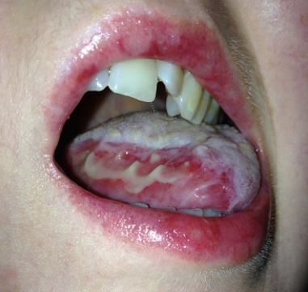
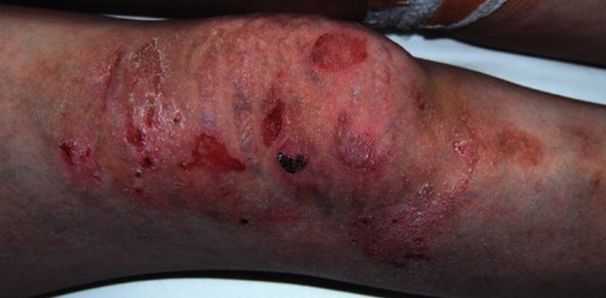
GVHD Definition
GVHD is a common immune inflammatory complication following allo-HSCT
Can affect any organ system and multiple systems simultaneously
Photos of severe upper GI and skin aGVHD courtesy of Kathryn Cartwright, NIH Image Gallery
  Most common: skin, GI tract, liver
  Sometimes: eyes, lungs, muscles/joints, genitalia
GI, gastrointestinal.

Slide 10


GVHD Catalyst and Causes
Graft as Invader
Causes and Risk Factors
Cells from allo-HSCT see new environment as foreign
Immunocompetent cells begin to attack host cells weakened by illness and preconditioning
This is war!
(aka, “cytokine storm”)
Incompatible HLA match
Older age of recipient and/or donor
Multiparous female donor to male recipient
Stem cells from peripheral blood rather than bone marrow or UCB
Ineffective GVHD prophylaxis
Intense preconditioning
aka, also known as; HLA, human leukocyte antigen; UBC, umbilical cord blood.
Nassereddine S, et al. Anticancer Res. 2017;37:1547-1555. Zeiser R, Blazar R. N Engl J Med. 2017;377:2167-2179.
Notes:
Nassereddine S, Rafei H, Elbahesh E, Tabbara I. Acute graft versus host disease: a comprehensive review. Anticancer Res. 2017;37:1547-1555.

Slide 11
General Incidence and Mortality
cGVHD
Up to 40% within 2 years for HLA-matched SD pairs³
20%–50% depending on preconditioning and prophylactic regimens as well as patient traits⁴
Mortality
GVHD the leading cause of NRM¹
46% 5-year survival aGVHD patients with HLA-matched SD donors⁵
77% 5-year survival for patients cGVHD⁶
aGVHD*
Estimates vary from 26%–59% within 100 days after transplant¹
39% among HLA-identical SD pairs²
59% for those receiving UD cells²
*Incidence and mortality higher in patients with higher severity grades. NRM, non-relapse mortality; SD, sibling donor; UD, unrelated donor.
1. Jagasia M, et al. Immunotherapy. 2018;10:391-402. 2. Jagasia M, et al. Blood. 2012;119:296-307. 3. Lazaryan A, et al. Biol. Blood Marrow Transplant. 2016;22:134–140. 4. Hill L, et al. Ther Adv Hematol. 2018;9:21-46. 5. Nassereddine S, et al. Anticancer Res. 2017;37:1547-1555. 6. Shokouhi S, et al. Int J Hematol Oncol Stem Cell Res. 2015;9:112-121.
Notes:
1. Jagasia M, Zeiser R, Arbushites M, Delaite P, Gadbaw B, Bubnoff NV. Ruxolitinib for the treatment of patients with steroid-refractory GVHD: an introduction to the REACH trials. Immunotherapy. 2018;10:391-402.
2. Jagasia M, Arora M, Flowers ME, et al. Risk factors for acute GVHD and survival after hematopoietic cell transplantation. Blood. 2012;119:296-307.
3. Lazaryan A, Weisdorf DJ, DeFor T, et al. Risk factors for acute and chronic graft-versus-host disease after allogeneic hematopoietic cell transplantation with umbilical cord blood and matched sibling donors. Biol. Blood Marrow Transplant. 2016;22:134–140.
4. Hill L, Alousi A, Kebriaei P, Mehta R, Rezvani K, Shpall E. New and emerging therapies for acute and chronic graft versus host disease. Ther Adv Hematol. 2018;9:21-46.
5. Nassereddine S, Rafei H, Elbahesh E, Tabbara I. Acute graft versus host disease: a comprehensive review. Anticancer Res. 2017;37:1547-1555.
6. Shokouhi S, Bray S, Bakhtiyari S, Sayehmiri K, Alimoghadam K, Ghavamzadeh A. Effects fo aGVHD and cGVHD on survival rate in patients with acute myeloid leukemia after allogeneic stem cell transplantation. Int J Hematol Oncol Stem Cell Res. 2015;9:112-121.

Slide 12
Steroid-Refractory Incidence and Mortality
Approximately 50% of GVHD patients develop steroid-refractory disease. This drives down response rates for control of GVHD and increases NRM.¹
Response Rate
Mortality Rate
40%–70% of GVHD patients develop suboptimal response to steroids^{2,3}
6-month mortality 51%⁴
1-year mortality 70%–80%^{5,6}
1. Hill L, et al. Ther Adv Hematol. 2018;9:21-46. 2. MacMillan ML, et al. Biol Blood Marrow Transplant 2002;8:387-394. 3. MacMillan ML, et al. Biol Blood Marrow Transplant 2015;21:761-767. 4. Jagasia M, Immunotherapy. 2018;10:391-402. 5. Martin PJ, et al. Biol Blood Marrow Transplant. 2012;18:1150-1163. 6. Xhaard A, et al. Biol Blood Marrow Transplant. 2012;18:406-413.
Notes:
1. Hill L, Alousi A, Kebriaei P, Mehta R, Rezvani K, Shpall E. New and emerging therapies for acute and chronic graft versus host disease. Ther Adv Hematol. 2018;9:21-46.
2. MacMillan ML, Weisdorf DJ, Wagner JE, et al. Response of 443 patients to steroids as primary therapy for acute graft-versus-host disease: comparison of grading systems. Biol Blood Marrow Transplant 2002;8:387-394.
3. MacMillan ML, Robin M, Harris AC, et al. A refined risk score for acute graft-versus-host disease that predicts response to initial therapy, survival, and transplant-related mortality. Biol Blood Marrow Transplant 2015;21:761-767.
4. Jagasia M, Zeiser R, Arbushites M, Delaite P, Gadbaw B, Bubnoff NV. Ruxolitinib for the treatment of patients with steroid-refractory GVHD: an introduction to the REACH trials. Immunotherapy. 2018;10:391-402.
5. Martin PJ, Rizzo JD, Wingard JR, et al. First- and second-line systemic treatment of acute graft-versus-host disease recommendations of the American Society of Blood and Marrow Transplantation. Biol Blood Marrow Transplant. 2012;18:1150-1163.
6. Xhaard A, Rocha V, Bueno B, et al. Steroid refractory acute GVHD: lack of long-term improved survival using new generation anti cytokine treatment. Biol Blood Marrow Transplant. 2012;18:406-413.

Slide 13
Pathobiology, GVL, and Signaling Pathways

Slide 14
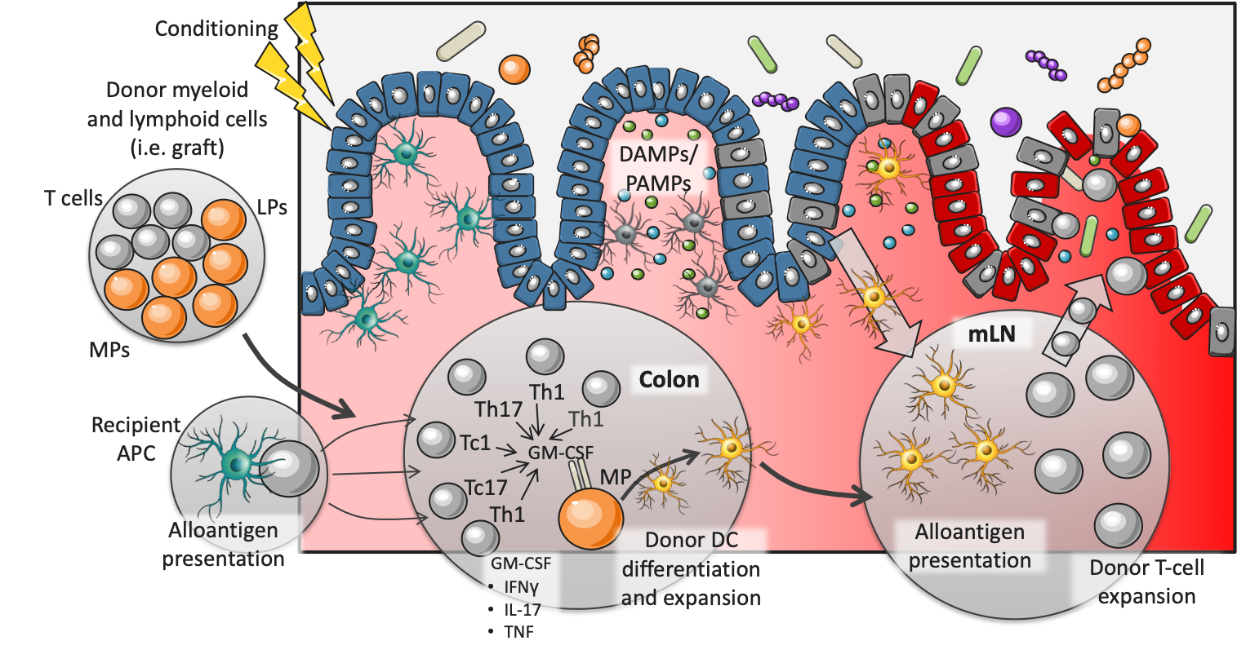
Pathogenesis of aGVHD
(ie, graft)
T-cells
APC, antigen-presenting cells; DAMP, damage-associated molecular patterns; GM-CSF, granulocyte-macrophage colony-stimulating factor; DC, dendritic cell; IFNγ, interferon gamma; IL-17, interleukin 17; mLN, mesenteric lymph node; PAMPs, pathogen-associated molecular patterns; TNF, tumor necrosis factor.
Adapted from: Gartlan KH, et al. Blood Adv. 2019;3:2859-2865.
Notes:
Gartlan KH, Koyama M, Lineburg KE, et al. Donor T-cell-derived GM-CSF drives alloantigen presentation by dendritic cells in the gastrointestinal tract. Blood Adv. 2019;3:2859-2865.

Slide 15
aGVHD → cGVHD Pathogenic Continuum
Both forms of GVHD start with alloreactive donor T-cells
  A complex interplay between donor and host immune cells causes a toxic inflammatory cascade
  Th17 and ILCs (which encompass NK cells) are activated in the lower GI tract leading to GVHD
  Donor T-cells contribute to destruction of the thymus
  Host innate and adaptive immune response accelerate B-cell activating factor and thymic dysregulation
    T-cells become dysregulated
    Pathogenic B-cell expansion promotes fibroblasts and tissue fibrosis
aGVHD organ damage caused primarily by premature, unregulated apoptosis
cGVHD organ damage marked mainly by fibrosis indicating B-cell dominant pathogenesis
ILCs, innate lymphoid cells; NK, natural killer.
Jagasia M, et al. Immunotherapy. 2018;10:391-402. Koyama M, et al. Blood. 2019;134:2139-2148. MacDonald KP, et al. Blood. 2017;129:13-21. Zeiser R, et al. Blood. 2018;131:1399-1405.
Notes:
Jagasia M, Zeiser R, Arbushites M, Delaite P, Gadbaw B, Bubnoff NV. Ruxolitinib for the treatment of patients with steroid-refractory GVHD: an introduction to the REACH trials. Immunotherapy. 2018;10:391-402.
Koyama M, Hill GR. The primacy of gastrointestinal tract antigen-presenting cells in lethal graft-versus-host disease. Blood. 2019;134:2139-2148.
MacDonald KP, Hill GR, Blazar BR. Chronic graft-versus-host disease: biological insights from preclinical and clinical studies. Blood. 2017;129:13-21.
Zeiser R, Sarantopoulos S, Blazar BR. B-cell targeting in chronic graft-versus-host disease. Blood. 2018;131:1399-1405.

Slide 16
aGVHD → cGVHD Pathogenic Continuum (cont)
cells into bloodstream
Allo/Auto Ab
Ab, antibody; BAFF, B-cell activating factor; CLP, common lymphoid progenitor; CSF-1, colony-stimulating factor 1; DC, dendritic cell; GCB, germinal center B-cells; GM-CSF, granulocyte-macrophage colony-stimulating factor; HSC, hematopoietic stem cell; IFNγ, interferon gamma; IL, interleukin; TFH, T-follicular helper cell; TGFβ, transforming growth factor beta; TN, naïve T-cells; TNF, tumor necrosis factor.
Adapted from: MacDonald KP, et al. Blood. 2017;129:13-21.
Notes:
MacDonald KP, Hill GR, Blazar BR. Chronic graft-versus-host disease: biological insights from preclinical and clinical studies. Blood. 2017;129:13-21.
Zeiser R, Sarantopoulos S, Blazar BR. B-cell targeting in chronic graft-versus-host disease. Blood. 2018;131:1399-1405.

Slide 17
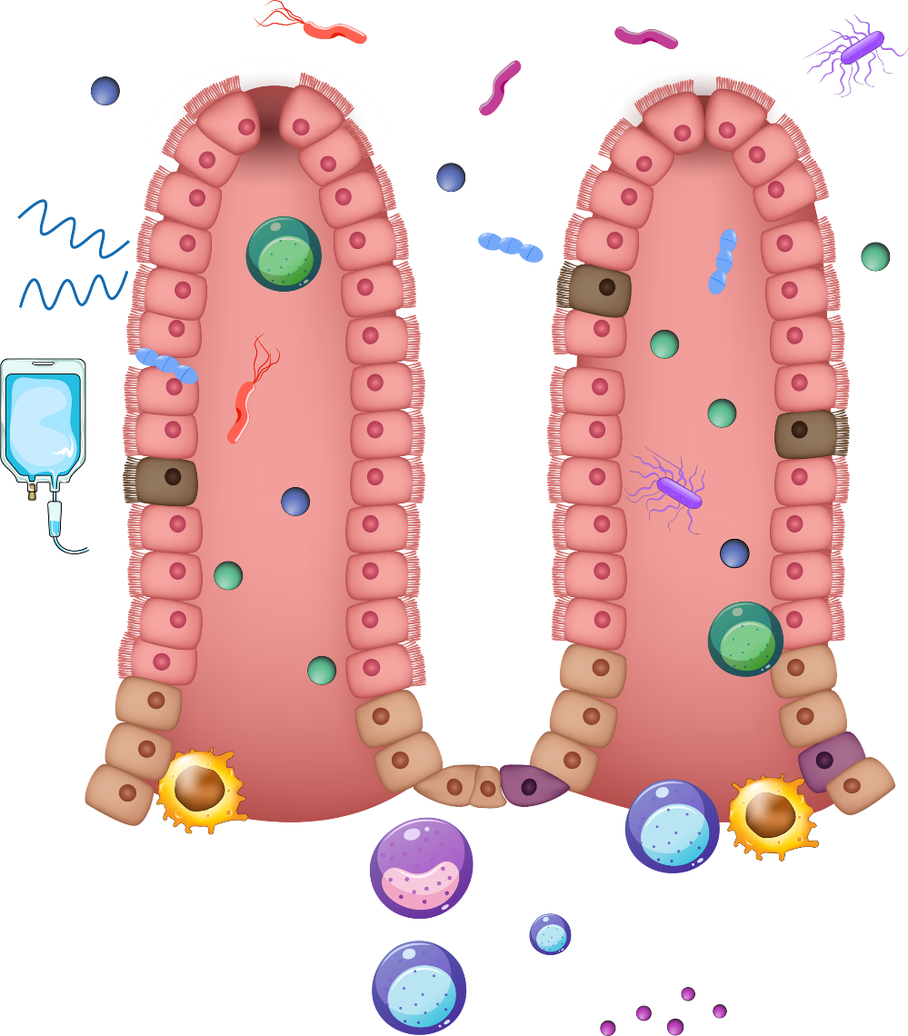
GVHD and the Gut Microbiome
Antimicrobial peptides
Proteobacteria
Healthy gut microbiota support and educate the immune system and maintain homeostasis.
Preconditioning regimens for
allo-HSCT damage the intestinal epithelial barrier, causing leaky junctions. Beneficial bacteria are reduced, resulting in harmful bacteria overgrowth. APCs present MAMPs and DAMPs to T-cells, promoting
T-cell activation and proliferation. This leads to cytokine storm and GVHD organ damage.
C difficile
Leaky junctions
Enterococci
TBI
Goblet cell loss
Increased permeability and translocation of bacteria
Goblet cell
Bacteria
MAMPs
DAMPs
Increased damage and inflammation
Chemotherapy
Cytotoxic CD8 T cell
Paneth cell loss
Paneth cell
Stem cell
Macrophage
B cells
Helper T_{H} cells
Activation of T-cells and APC and pro-inflammatory cytokine secretion
Plasma cell
DAMPs, danger-associated molecular patterns; MAMPs, microbe-associated molecular patterns.
Adapted from: Kumari R, et al. Dig Dis Sci. 2019;64:669-677.
T_{H} cells
Cytokines
Notes:
Kumari R, Palaniyandi S, Hildebrandt GC. Microbiome: an emerging new frontier in graft-versus-host disease. Dig Dis Sci. 2019;64:669-677.

Slide 18
GVL and GVHD
GVL is the hoped for curative response to allo-HSCT
  Immunocompetent donor T-cells focus on malignant cells
GVHD the molecularly malevolent flip side
  Donor immune cells don’t discriminate – healthy host cells are attacked in addition to diseased cells
Negrin RS, et al. Hematology Am Soc Hematol Educ Program. 2015;2015:225-230. Zeiser R, et al. Br J Haematology. 2019;187:563-572.
Notes:
Negrin RS. Graft-versus-host disease versus graft-versus-leukemia. Hematology Am Soc Hematol Educ Program. 2015;2015:225-230.
Zeiser R. Advances in understanding the pathogenesis of graft-versus host disease. Br J Haematology. 2019;187:563-572.

Slide 19
GVHD
When allo-HSCT goes well: GVL
Cure
Reduced risk of relapse
Malignant cells
are targeted
Malignant cells
are destroyed

Slide 20
GVHD
When allo-HSCT goes bad: GVHD
Alloreactive T-cells infiltrate lymphoid organs
Cells proliferate and migrate to peripheral blood
Pro-inflammatory signaling cascades are activated
Tissue damage accumulates
Organ failure & NRM

Slide 21
Unraveling GVL from GVHD
GVL and GVHD integrally intertwined with T-cell effector functions
Translational science teasing apart these post-HSCT effects¹
  T-cell receptor high-throughput sequencing
Efforts to ↑ GVL and ↓ GVHD
  Controlling T-cell proliferation with immunosuppressive drugs^{3,4}
    CNIs, MTX, MMF, and sirolimus after myoablative conditioning
    Cyclophosphamide and MTX post-transplant⁵
  Finding biomarkers to identify those at highest risk⁶
    IL-2Rα, REG3α, ST2, TNFαR1 – all associated with more-severe aGVHD
  Inhibiting T-cell and B-cell proliferation through downstream signaling⁷
    JAK and BTK
BTK, Bruton’s tyrosine kinase; CNIs, calcineurin inhibitors; IL-2Rα, interleukin 2 receptor alpha; JAK, Janus kinase; MMF, mycofenolate mofetil; MTX, methotrexate; REG3α, regenerating family member 3 alpha; ST2, suppression of tumorigenicity 2; TNFαR1, tumor necrosis factor alpha receptor 1.
1. Negrin RS. Hematology Am Soc Hematol Educ Program. 2015;2015:225-230. 2. Chhabra S, et al. Biol Blood Marrow Transplant. 2019;25:73-85. 3. Ciurea SO, et al. Blood. 2015;126:1033-1040. 4. Zeiser R, et al. N Engl J Med. 2017;377:2167-2179. 5. Zeiser R, et al. Blood. 2018;131:1399-1405.
Notes:
1. Negrin RS. Graft-versus-host disease versus graft-versus-leukemia. Hematology Am Soc Hematol Educ Program. 2015;2015:225-230.
2. Chhabra S, Hemmer MT, Costa L, et al. Comparative analysis of calcineurin inhibitor-based methotrexate and mycophenolate mofetil-containing regimens for prevention of graft-versus-host disease after reduced-intensity conditioning allogeneic transplantation. Biol Blood Marrow Transplant. 2019;25:73-85.
3. Ciurea SO, Zhang MJ, Bacigalupo AA, et al. Haploidentical transplant with posttransplant cyclophosphamide vs matched unrelated donor transplant for acute myeloid leukemia. Blood. 2015;126:1033-1040.
4. Zeiser R, Blazar R. Acute graft-versus-host disease—biologic process, prevention, and therapy. N Engl J Med. 2017;377:2167-2179.
5. Zeiser R, Sarantopoulos S, Blazar BR. B-cell targeting in chronic graft-versus-host disease. Blood. 2018;131:1399-1405.

Slide 22
JAK Pathway in aGVHD
JAK inhibition
IFNγ and interleukins 6, 11, 12, 23, and 27
JAK is a family of intracellular non-receptor tyrosine kinase enzymes that play an integral role in T-cell proliferation and activation.
Interleukins are known to be mediated through JAK signaling to increase the number of T_{Reg} cells while IFNγ is involved in B-cell expansion
Interferon-γ and interleukins 6, 11, 12, 23, and 27
Interleukins 2, 4, 7, 9, 15, and 21
JAK 1, 2
inhibitor
JAK 2, 3
inhibitor
JAK 1
JAK 2
JAK 2
JAK 3
P
STAT
STAT
P
Nucleus
Transcription of proinflammatory genes
JAK/STAT, Janus kinase/signal transducers and activators of transcription.
Jagasia M, et al. Immunotherapy. 2018;10:391-402.
Adapted from: Zeiser R, Blazar BR. N Engl J Med. 2017;377:2167-2179.
Notes:
Jagasia M, Zeiser R, Arbushites M, Delaite P, Gadbaw B, Bubnoff NV. Ruxolitinib for the treatment of patients with steroid-refractory GVHD: an introduction to the REACH trials. Immunotherapy. 2018;10:391-402.
Zeiser R, Blazar R. Acute graft-versus-host disease—biologic process, prevention, and therapy. N Engl J Med. 2017;377:2167-2179.

Slide 23
BTK Pathway in cGVHD
BTK is a non-receptor tyrosine kinase produced downstream of BCR activation.
BTK activation is critical for B-cell survival, proliferation, and migration and is expressed almost exclusively in B-cells.
CD37
CD19
CD20
Ibrutinib
PIP2
PIP3
PI3K
BTK
PLCγ2
LYN
LYN
BLNK
SYK
SYK
AKT
Cell survival
Proliferation
Migration
DAG
BCL2
IP3
AKT, acutely transforming retrovirus; BCL2, B-cell lymphoma 2 gene; BLNK, B-cell linker protein; BCR, B-cell receptor; DAG, diacylglycerol; IP3, inositol (1,4,5)-triphosphate; LYN, Lck/Yes novel tyrosine kinase; PI3K, phosphatidylinositol 3-kinase; PIP2/PIP3, phosphatidylinositol (4,5)-bisphosphate 2 or 3; PLCγ2 phosphoinositide-specific phospholipase C gamma 2; SYK, spleen tyrosine kinase.
Adapted from: Jaglowski SM, Blazar BR. Blood Adv. 2018;2:2012-2019.
Notes:
Jaglowski SM, Blazar BR. How ibrutinib, a B-cell malignancy drug, became an FDA-approved second-line therapy for steroid-resistant chronic GVHD. Blood Adv. 2018;2:2012-2019.

Slide 24
Differentiating, Classifying,
Grading/Staging

Slide 25
NIH Consensus Criteria
Diagnosing GVHD complicated by overlapping clinical manifestations
  aGVHD signs can present after 100 days post-transplant
  cGVHD manifestations can present any time post-transplant
  Some signs/symptoms are diagnostic/distinctive only for cGVHD
  Other signs/symptoms overlap aGVHD and cGVHD
NIH consensus criteria for diagnosing aGVHD and cGVHD originally released in 2005¹
Criteria further refined in 2015²
Consensus criteria now use 4 subclasses based
  Timing and clinical features
1. Filipovich AH, et al. Biol Blood Marrow Transplant. 2005;11:945. 2. Jagasia MH, et al. Blood Marrow Transplant. 2015;21:389-401.
Notes:
Filipovich AH, Weisdorf D, Pavletic S, et al. National Institutes of Health consensus development project on criteria for clinical trials in chronic graft-versus-host disease: I. Diagnosis and staging working group report. Biol Blood Marrow Transplant. 2005;11:945.
Jagasia MH, Greinix HT, Arora M, et al. National Institutes of Health consensus development project on criteria for clinical trials in chronic graft-versus-host disease: I. The 2014 Diagnosis and Staging Working Group Report. Biol Blood Marrow Transplant. 2015;21:389-401.

Slide 26
NIH GVHD Classification Categories
Signs appear ≤100 days after HSCT and display features of aGVHD.
No D/D features
of cGVHD
Signs appear >100 days after HSCT with features of aGVHD. No D/D features of cGVHD
Persistent, recurrent, late-onset acute GVHD
Classic acute GVHD
Classic chronic GVHD
Overlap syndrome
Signs appear any time after HSCT with features of cGVHD. No features of aGVHD
Signs appear any time after HSCT with features of both cGVHD and aGVHD
D/D, diagnostic/distinctive.
Filipovich AH, et al. Biol Blood Marrow Transplant. 2005;11:945. Jagasia MH, et al. Blood Marrow Transplant. 2015;21:389-401.

Slide 27
aGVHD MAGIC Staging by Organ Involvement
Organ | Stage | Description
Skin | 1 | Maculopapular rash over <25% of body
 | 2 | Maculopapular rash over <25%–50% of body
 | 3 | Generalized erythroderma
 | 4 | Generalized erythroderma with bullae and often desquamation
Liver | 1 | Bilirubin 2.0–3.0 mg/dL; AST 150–750 IU
 | 2 | Bilirubin 3.1–6.0 mg/dL
 | 3 | Bilirubin 6.1–15.0 mg/dL
 | 4 | Bilirubin >15.0 mg/dL
Gut | 1 | Diarrhea >30 mL/kg or >500 mL/day
 | 2 | Diarrhea >60 mL/kg or >1000 mL/day
 | 3 | Diarrhea >90 mL/kg or >1500 mL/day
 | 4 | Diarrhea >90 mL/kg or >2000 mL/day; or severe pain with or without ileus
Harris AC, et al. Biol Blood Marrow Transplant. 2016;22:4-10. .
AST, aspartate aminotransferase; MAGIC, Mount Sinai Acute GVHD International Consortium.
Notes:
Harris AC, Young R, Devine S, et al. International, multi-center standardization of acute graft-versus-host disease clinical data collection: a report from the MAGIC consortium. Biol Blood Marrow Transplant. 2016;22:4-10.

Slide 28
aGVHD Most Common Grading Systems
aGVHD MAGIC organ staging is paired with severity grading systems.
Most Widely Used Severity Grading Systems
Severity | Glucksberg¹ |  | CIBMTR²
Mild | I | Stage 1–2 skin involvement; no liver or gut involvement; ECOG PS 0 | A | Stage 1 skin involvement; no liver or gut involvement
Moderate | II | Stage 1–2 skin involvement; Grade 1 liver or gut involvement; ECOG PS 1 | B | Stage 2 skin involvement; Stage 1–2 gut or liver involvement
Severe | III | Stage 2–3 skin, liver, or gut involvement; ECOG PS 2 | C | Stage 3 skin, liver, or gut involvement
Life-threatening | IV | Stage 1–4 skin involvement, Stage 2–4 liver or gut involvement; ECOG PS 3 | D | Stage 4 skin, liver, or gut involvement
CIBMTR, Center for Blood and Marrow Transplant Research; ECOG PS, Eastern Cooperative Oncology Group Performance Status.
1. Glucksberg H, et al. Transplantation. 1974;18:295-304. 2. Rowlings PA, et al. Br J Haematol. 1997;97:855-864.
Notes:
Glucksberg H, Storb R, Fefer, et al. Clinical manifestations of graft-versus-host disease in human recipients of marrow from HLA-matched sibling donors. Transplantation. 1974;18:295-304.
Rowlings PA, Przepiorka D, Klein JP, et al. IBMTR Severity Index for grading acute graft-versus-host disease: retrospective comparison with Glucksberg grade. Br J Haematol. 1997;97:855-864.

Slide 29





New aGVHD Risk Scoring System
Introduced in 2012, the Minnesota Risk Score was designed to identify aGVHD patients at risk for steroid-refractory disease and NRM
Using CIBMTR staging, patients
stratified into 2 cohorts:
  Standard risk
  High risk
  (less likely to
  respond to steroids
  by day 28)
High-Risk Categories
One Organ
Two Organs
1-4
1-2
1
Stage 1-3 Skin
Stage 1-2 GI
Stage 1-3 Skin
plus Stage 1 GI
Stage 1-3 Skin
plus Stage 1-4 Liver
Adapted from: MacMillan ML, et al. Biol Blood Marrow Transplant. 2015;21:761-767.
Notes:
MacMillan ML, Robin M, Harris AC, et al. A refined risk score for acute GVHD that predicts response to initial therapy, survival and transplant-related mortality. Biol Blood Marrow Transplant. 2015;21:761-767.

Slide 30
NIH Consensus Criteria for cGVHD
Signs that are distinctive or diagnostic of cGVHD by organ system were updated by NIH Consensus Criteria published in 2015
Organ/ System | Diagnostic (Sufficient for cGVHD Dx) | Distinctive* (Seen in cGVHD, but insufficient for Dx) | Common (Seen in both cGVHD and aGVHD)
Skin | Lichen planus-like features Lichen sclerosis-like features Morphea-like features Poikiloderma Sclerotic features | Depigmentation Papulosquamous lesions | Erythema Maculopapular rash Pruritus
GI Tract | Eosphageal web Strictures or stenosis in upper esophagus | – | Anorexia Diarrhea Nausea/vomiting Weight loss
*Biopsy and laboratory confirmation needed.
Jagasia MH, et al. Biol Blood Marrow Transplant. 2015;21:389-401.
Notes:
Jagasia MH, Greinix HT, Arora M, et al. National Institutes of Health consensus development project on criteria for clinical trials in chronic graft-versus-host disease: I. The 2014 Diagnosis and Staging Working Group Report. Biol Blood Marrow Transplant. 2015;21:389-401.

Slide 31
NIH Consensus Criteria for cGVHD (cont)
Organ/ System | Diagnostic (Sufficient for cGVHD Dx) | Distinctive (Seen in cGVHD, but insufficient for Dx) | Common (Seen in both cGVHD and aGVHD)
Mouth | Lichen planus-like changes | Mucoceles Mucosal atrophy Pseudomembranes Ulcers Xerostomia | Erythema Gingivitis Mucositis Pain
Liver | – | – | Total BILI, ALP 2 x ULN ALT >2 x ULN
Musculoskeletal | Fasciitis Joint stiffness or contracture secondary to fasciitis or sclerosis | Myositis or polymyositis | –
ALP, alkaline phosphatase; ALT, alanine aminotransferase; BILI, bilirubin; ULN, upper limit of normal
Jagasia MH, et al. Biol Blood Marrow Transplant. 2015;21:389-401.

Slide 32
NIH Consensus Criteria for cGVHD (cont)
Organ/ System | Diagnostic (Sufficient for cGVHD Dx) | Distinctive (Seen in cGVHD, but insufficient for Dx) | Common (Seen in both cGVHD and aGVHD)
Lungs | Bronchiolitis obliterans diagnosed with lung biopsy Bronchiolitis obliterans syndrome | Air trapping and bronchiectasis on CT | –
Genitals | Lichen planus-like features Lichen sclerosis-like features Phimosis or urethral/meatus scarring or stenosis Vaginal scarring or clitoral/labial agglutination | Erosions Fissures Ulcers | –
CT, computed tomography.
Jagasia MH, et al. Biol Blood Marrow Transplant. 2015;21:389-401.

Slide 33
Existing, New, and Emerging
Treatment Options

Slide 34
Drugs Approved for Steroid-Refractory Treatment
1st-line SOC for GVHD has been high-dose steroids for decades . . . but there has been no SOC for the ≥50% of steroid-refractory patients
 | Ibrutinib for cGVHD¹ | Ruxolitinib for aGVHD²
Approval trial | PCYC-1129-CA³ (NCT02195869) Phase 1b/2 | REACH-1⁴ (NCT0295368) Phase 2
Approval Date | August 2, 2017 | May 24, 2019
Target | BTK | JAK1 and JAK2
Dosing for GVHD | 420 mg QD, capsules | 10 mg QD, tablets
Common AEs | >20%: anemia, bruising, diarrhea, fatigue, hemorrhage, muscle spasms, nausea, pneumonia, thrombocytopenia | >50%: anemia, edema, infections, neutropenia, thrombocytopenia
Other approved indications | MCL (2013) • CLL/SLL(2014) WM (2015) • MZL (2017) | MF (2011) • PV (2014) PV/PET-MF/PPV-MF (2014)
CLL, chronic lymphocytic leukemia; MCL, mantle cell lymphoma; MF, myelofibrosis; MZL, marginal zone lymphoma; PET-MF, post-essential thrombocytothemia myelofibrosis; PPV-MF, post-polycythemia vera myelofibrosis; PV, polycythemia vera; SLL, small lymphocytic leukemia; Waldenström’s macroglobulinemia.
1. Ibrutinib [Imbruvica®] PI 2019. 2. Ruxolitinib [Jakafi®] PI 2019. 3. Miklos D, et al. Blood. 2017;130:2243-2250. 4. Jagasia M, et al. Biol Blood Marrow Transplant. 2019;25:S52.
Notes:
1. Ibrutinib [Imbruvica® package insert]. Sunnyvale, CA: Pharmacyclics LLC; 2019. https://www.accessdata.fda.gov/drugsatfda_docs/label/2019/205552s029,210563s004lbl.pdf. Accessed January 8, 2020.
2. Ruxolitinib [Jakafi® package insert]. Wilmington, DE: Incyte Corporation; 2019. ruxolitinibhttps://www.accessdata.fda.gov/drugsatfda_docs/label/2019/202192s017lbl.pdf. Accessed January 8, 2019.
3. Miklos D, Cutler CS, Waller EK, et al. Ibrutinib for chronic graft-vs-host disease after failure of prior therapy. Blood. 2017;130:2243-2250.
4. Jagasia M, Ali H, Schroeder MA, et al. Ruxolitinib in combination with corticosteroids for the treatment of steroid-refractory acute graft-vs-host disease: results from the phase 2 REACH1 trial. Biol Blood Marrow Transplant. 2019;25:S52.

Slide 35
Ibrutinib: Improvement in Severity Scores
Week 0 5 13 25 37 49
Clinician 41 11 34 20 17 15
Patient 42 10 31 18 16 14
Adapted from: Miklos D, et al. Blood. 2017;130:2243-2250.
Notes:
Miklos D, Cutler CS, Waller EK, et al. Ibrutinib for chronic graft-vs-host disease after failure of prior therapy. Blood. 2017;130:2243-2250.

Slide 36
Ruxolitinib: Efficacy and Duration of Response
REACH-1 median time to first response: 7 days¹
  Median DOR (from first response until GVHD progression or death): 345 days
Different protein expressions in responders vs non-responders²
  In responders, IL-6, IL-8, and IL-24 frequently downregulated; SCF most upregulated
DOR, duration of response; SCF, Smith, Cullin, F-box containing complex.
1. Jagasia M, et al. Biol Blood Marrow Transplant. 2019;25:S52. 2. Owens S, et al. ASH 2019. Abstract 4531.
Notes:
Jagasia M, Ali H, Schroeder MA, et al. Ruxolitinib in combination with corticosteroids for the treatment of steroid-refractory acute graft-vs-host disease: results from the phase 2 REACH1 trial. Biol Blood Marrow Transplant. 2019;25:S52.
Owens S, Pratta MA, Liu H, Arbushites MC, Tian C, Howell MD. Statification of responders and non-responders in the REACH-1 trial based on serum proteomic analysis. Presented at: 61st Annual Meeting of the American Society of Hematology (ASH); December 7–10, 2019; Orlando, FL. Abstract 4531.

Slide 37
2nd-Line Treatments for Steroid-Refractory aGVHD in Clinical Trials
Steroids are always the 1st-line SOC for aGVHD, but several agents have completed clinical trials for 2nd-line treatment of steroid-refractory disease.
Agents* | Target | Trial ID Phase (# Pts) | Results / Main Safety Finding
Alpha-1 antitrypsin | PI | NCT01700036 2 (N=40) | ORR 65%; CR 35%. Sustained responses in 73% by day 60 / 10% mortality due to infections at 6 mos
Etanercept | TNFα | NCT00141713 2 (N=61) | CR 69% for ETAN+CS vs 33% for CS alone. Survival at day 100: 82% for ETAN+CS vs 66% for CS-only / High but similar infection rates in both cohorts
MMF | IMPDH | NCT01002742 3 (N=235) | Trial was terminated early after it failed to meet its primary endpoint of GVHD-free survival by day 56 / MMF associated with higher incidence of leukopenia
*Arranged in alphabetical order.
CR, complete response; CS, corticosteroids; ETAN, etanercept; IMPDH inosine monophosphate dehydrogenase; MMF, mycophenolate mofetil; ORR, overall response rate; PI, protease inhibitor.
Chao N. Treatment of acute graft-versus-host disease. UpToDate. Last updated: Jul 11, 2019. www.uptodate.com. Accessed 01/08/2020,
Notes:
Chao N. Treatment of acute graft-versus-host disease. UpToDate. Last updated: July 11, 2019. https://www.uptodate.com/contents/overview-of-immunosuppressive-agents-used-for-prevention-and-treatment-of-graft-versus-host-disease?sectionName=Ruxolitinib&search=Minnesota%20grading%20for%20graft%20vs%20host&topicRef=3543&anchor=H298036777&source=see_link#H3. Accessed January 8, 2020.
Jagasia MD, Ali H, Schroeder MA, et al. Ruxolitinib in combination with corticosteroids for the treatment of steroid-refractory acute graft-vs-host disease: results from the phase 2 reach1 trial. Biol Blood Marrow Transplant. 2019;25:S52.

Slide 38
2nd-Line Treatments for Steroid-Refractory aGVHD in Clinical Trials (cont)
Agents* | Target | Trial ID Phase (# Pts) | Results / Main Safety Finding
Pentostatin | ADA | ID N/A 1 (N=23) | CR 63%; PR 13%. Median survival 85 days / Lymphopenia in 100% of pts
Sirolimus | mTOR | ID N/A 2 (N=35) | ORR 63%; CR 24% / TEAEs: thrombocytopenia (33%), HUS (24%), neutropenia (19%)
*Arranged in alphabetical order. †Jagasia MD, et al. Biol Blood Marrow Transplant. 2019;25:S52.
‡Percentages are rounded.
ADA, adenosine deaminase; HUS, hemolytic uremic syndrome; mDOR, median duration of response; mTOR, mammalian target of rapamycin; N/A, not applicable; TEAEs, treatment-emergent adverse events.
Chao N. Treatment of acute graft-versus-host disease. UpToDate. Last updated: Jul 11, 2019. www.uptodate.com. Accessed 01/08/2020.
Notes:
Chao N. Treatment of acute graft-versus-host disease. UpToDate. Last updated: July 11, 2019. https://www.uptodate.com/contents/overview-of-immunosuppressive-agents-used-for-prevention-and-treatment-of-graft-versus-host-disease?sectionName=Ruxolitinib&search=Minnesota%20grading%20for%20graft%20vs%20host&topicRef=3543&anchor=H298036777&source=see_link#H3. Accessed January 8, 2020.
Jagasia MD, Ali H, Schroeder MA, et al. Ruxolitinib in combination with corticosteroids for the treatment of steroid-refractory acute graft-vs-host disease: results from the phase 2 reach1 trial. Biol Blood Marrow Transplant. 2019;25:S52.

Slide 39
ECP in 2nd-Line for GVHD
ECP uses UVA to irradiate autologous PBMCs before reinfusing into the patient
A literature review including 735 patients with steroid-refractory GVHD found
  ORR 50%–65%, CR 30%–35%
  25%–30% were able to taper steroid use
Unfortunately, ECP has been limited by lack of access and time for most patients
  Few specialized centers to offer the procedure
  Procedure requires 2 or 3 visits per week for 1st 12 weeks and every 4 weeks thereafter until week 24
ECP, extracorporeal photophoresis, PBMC, peripheral blood mononuclear cells; UVA, ultraviolet.
Pierelli L, et al. Transfusion. 53:2340-2352. Rafei H, et al. Biomedicines. 2017;5:60.
Notes:
Pierelli L, Perseghin P, Marchetti M, et al. Extracorporeal photopheresis for the treatment of acute and chronic graft-versus-host disease in adults and children: best practice recommendations from an Italian Society of Hemapheresis and Cell Manipulation (SIdEM) and Italian Group for Bone Marrow Transplantation (GITMO) consensus process. Transfusion. 53:2340-2352.
Rafei H, Kharfan-Dabaja MA, Nishihori T. A Critical appraisal of extracorporeal photopheresis as a treatment modality for acute and chronic graft-versus-host disease. Biomedicines. 2017;5:60.

Slide 40





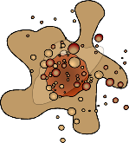



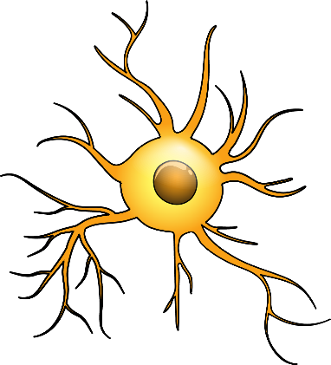
ECP Mechanism of Action
T-naive
TNF-⍺
Macrophage
Monocyte
UVA light (ECP) + 8-MOP
Apoptosis
T-effector
Immature DC
IL-6
B cell
T-naive
T-effector
Foxp3
T-reg
(–)
Reinfusion to patient
(+)
IL-10
T-naive
Foxp3
T-reg
(+)
IL-1Ra
Adapted from: Hart JW, et al. Ther Adv Hematol. 2013;4:320-334.
Dendritic cell
Notes:
Hart JW, Shiue LH, Shpall EJ, Alousi AM. Extracorporeal photopheresis in the treatment of graft-versus-host disease: evidence and opinion. Ther Adv Hematol. 2013;4:320-334.

Slide 41
Agents in Ongoing Phase 2 Clinical Trials
Agent | Target | Trial ID# | # Pts | Completion
Atorvastatin | HMG-CoA | NCT01665677 | N=60 | December 2023
Defibrotide | anti-thrombotic | NCT03339297 | N=150 | January 2020
Itacitanib | JAK1 | NCT03846479 | N=70 | December 2021
KD025 | ROCK | NCT03640481 | N=126 | January 2022
Letolizumab | CD40-L | NCT03605927 | N=45 | January 2024
Natalizumab | IRA | NCT02133924 | N=90 | December 2020
Panobinostat | HDAC | NCT02588339 | N=42 | December 2020
RGI-2001 | T_{reg} | NCT04014790 | N=50 | May 2022
CD40-L, cluster of differentiation 40 ligand; HDAC, histone deacetylase; HMG-CoA, 3-hydroxy-3-methylglutaryl-CoA; ROCK, Rho-associated kinase; T_{reg}, regulatory T-cells.
Source: ClinicalTrials.gov using filters for “acute graft versus host disease,” “interventional,” “active not recruiting,” and “phase 2.” February 2020.

Slide 42
Agents in Ongoing Phase 3 Clinical Trials
Agent | Target | Trial Name and/or ID# | # Pts | Focus | Completion
Ibrutinib | BTK | NCT03474679 | N=19 | SR cGVHD | June 2022
 |  | iNTEGRATE NCT02959944 | N=186 | New-onset cGVHD | March 2023
Ruxolitinib | JAK1 | REACH2 NCT02913261 | N=310 | SR aGVHD | April 2021
 |  | REACH3 NCT03112603 | N=330 | SR cGVHD | January 2022
Vedolizumab | IRA | NCT03657160 | N=558 | Prevention of aGVHD | April 2021
IRA, integrin receptor antagonist.
Source: ClinicalTrials.gov using filters for “graft versus host disease,” “active not recruiting,” “interventional,” and “phase 3.” February 2020.

Slide 43
Emerging Agent: Antithrombin
Defibrotide, approved in 2016 for VOD (aka, SOS) with renal or pulmonary dysfunction following HSCT
Binds with bFGF to induce VEGF and protect endothelial cells
Functions as
  Antithrombotic
  Profibrinolytic
  Anti-inflammatory
bFGF, basic fibroblast growth factor; SOS, sinusoidal obstruction disorder; VEGF, vascular endothelial growth factor; VOD, veno-occlusive disease.
Richardson PG, et al. Blood Adv. 2018;2:1495-1509.
Notes:
Richardson PG, Carreras E, Iacobelli M, Nejadnik B. The use of defibrotide in blood and marrow transplantation. Blood Adv. 2018;2:1495-1509.

Slide 44
Summary
GVHD is graft (transplanted cells) attacking host (recipient) cells → tissues → organs
Skin, GI tract, liver are most frequent targets but any organ can be affected
aGVHD and cGVHD are now differentiated by clinical manifestations rather than by time of onset
No SOC for steroid-refractory GVHD — the leading cause of non-relapse mortality
Two new agents using the JAK and BTK signaling pathways approved for aGVHD and cGVHD
  JAK inhibitor ruxolitinib for aGVHD
  BTK inhibitor ibrutinib for cGVHD

Slide 45
Case Studies

Slide 46
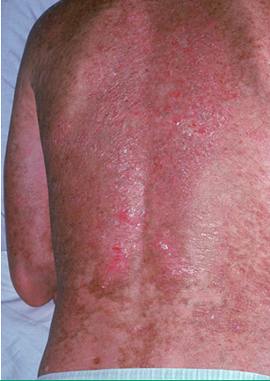
Case Study 1: aGvHD Presentation
Paul is a 60-year-old man who underwent allo-HSCT for AML
He presents 10 weeks later with
  Elevated ALK and bilirubin levels
  Widespread, erythemic rash with blistering
  Erythroderma with bullae defines Stage 4^{1,2}
  ~15% of GVHD patients have skin involvement only; ~4% skin and liver involvement³
Stage 4 cutaneous GvHD. Source: UpToDate
1. Przepiorka D, et al. Bone Marrow Transplant. 1995;15:825-828. 2. Chao NJ. UpToDate. Last updated: Jul 3, 2019. www.uptodate.com. Accessed 01/08/2020. 3. Ratanatharathorn V, et al. Blood. 1998;92:2303-2314.
Notes:
1. Przepiorka D, Weisdorf D, Martin P, et al. 1994 consensus conference on acute GVHD grading. Bone Marrow Transplant. 1995;15:825-828.
2. Chao NJ. Clinical manifestations, diagnosis, and grading of acute graft-versus-host disease. UpToDate. Last updated: July 3, 2019. https://www.uptodate.com/contents/clinical-manifestations-diagnosis-and-grading-of-acute-graft-versus-host-disease?search=graft%20versus%20host%20disease&topicRef=13760&source=see_link#H4. Accessed January 6, 2020.
3. Ratanatharathorn V, Nash RA, Przpiorka D, et al. Phase III study comparing methotrexate and tacrolimus (prograf, FK506) with methotrexate and cyclosporine for graft-versus-host disease prophylaxis after HLA-identical sibling bone marrow transplantation. Blood. 1998;92:2030-2314.

Slide 47
Case Study 1: aGvHD Treatment
How would you treat Paul?
  Skin biopsy should be done for histopathologic confirmation of aGVHD¹
  Steroids are the standard initial therapy for patients with aGVHD²
Paul shows no improvement after 1 week of prednisone
Platelet count is 50 x 10⁹/L
Only 1 agent approved for steroid-resistant aGVHD — JAK inhibitor ruxolitinib
Starting dose 5 mg BID³
  Dose can be ↑ to 10 mg BID after ≥3 days if platelet count not ↓ by ≥50%⁴
  Tapering can be considered after 6 months
1. Cowan EW. UpToDate. Last updated: Jan 17, 2019. www.uptodate.com. Accessed 01/08/2020. 2. Martin PJ, et al. Biol Blood Marrow Transplant. 2012;18:1150-1163. 3. Ruxolitinib [Jakafi®] PI 2019.
Notes:
1. Cowan EW. Cutaneous manifestations of graft-versus-host disease (GVHD). UpToDate. Last updated: January 17, 2019. https://www.uptodate.com/contents/cutaneous-manifestations-of-graft-versus-host-disease-gvhd?search=graft%20versus%20host%20disease&source=search_result&selectedTitle=5~150&usage_type=default&display_rank=5#H832193. Accessed January 8, 2020.
2. Martin PJ, Rizzo JD, Wingard JR, et al. First- and second-line systemic treatment of acute graft-versus-host disease recommendations of the American Society of Blood and Marrow Transplantation. Biol Blood Marrow Transplant. 2012;18:1150-1163.

Slide 48
Case Study 2: cGvHD Presentation
Laura is a 56-year-old woman with MDS who underwent myoablative transplant with matched sibling donor
  6 weeks later she developed aGVHD, which resolved with high-dose steroid
  Now, 9 months later, she presents with Stage 3 rash (generalized erythema) and diarrhea (1500–2000 mL/day)¹
    ~24% of GvHD patients have GI tract and skin involvement²
Clinical exam also reveals evidence of joint sclerosis and restricted range of motion in fingers and wrists
  NIH consensus criteria consider joint sclerosis diagnostic for cGVHD
1. Rowlings PA, et al. Br J Haematol. 1997;97:855-864, 2. Ratanatharathorn V, et al. Blood. 1998;92:2303-2314. 3. Jagasia MH, et al. Biol Blood Marrow Transplant. 2015;21:389-401.
Notes:
1. Rowlings PA, Przepiorka D, Klein JP, et al. IBMTR Severity Index for grading acute graft-versus-host disease: retrospective comparison with Glucksberg grade. Br J Haematol. 1997;97:855-864.
2. Ratanatharathorn V, Nash RA, Przpiorka D, et al. Phase III study comparing methotrexate and tacrolimus (prograf, FK506) with methotrexate and cyclosporine for graft-versus-host disease prophylaxis after HLA-identical sibling bone marrow transplantation. Blood. 1998;92:2030-2314.
3. Jagasia MH, Greinix HT, Arora M, et al. National Institutes of Health consensus development project on criteria for clinical trials in chronic graft-versus-host disease: I. The 2014 Diagnosis and Staging Working Group Report. Biol Blood Marrow Transplant. 2015;21:389-401.

Slide 49
Case Study 2: Testing and Initial Treatment
Additional testing
  Test for CMV
  Consider skin biopsy and colonoscopy
Initial treatment
  1 mg/kg/day of prednisone
  Add a CNI (cyclosporine or tacrolimus)
Laura’s cGVHD has not improved after 2 weeks despite steroid + CNI
Platelet count is 40 x 10⁹/L
Which other treatment options would you consider?

Slide 50
Case Study 2: Additional Treatment Options
Clinical trial
Extra corporeal photopheresis
  Can be effective in steroid-resistant GVHD¹
  Low availability limits access
Add ibrutinib to CNI²
  This BTK inhibitor the only treatment approved specifically for cGVHD
  Approved in second line, after ≥1 systemic treatments
  Dosing 420 mg QD
Add ruxolitinib to CNI³
  JAK 1/2 inhibitor in phase 3 trial for cGVHD
  Use for cGVHD would be off-label
1. Pierelli L, et al. Transfusion. 2013;53:2340-2352. 2. Ibrutinib [Imbruvica ®] PI 2019. 3. Ruxolitinib [Jakafi®]. PI 2019.
Notes:
1. Pierelli L, Perseghin P, Marchetti M, et al. Extracorporeal photopheresis for the treatment of acute and chronic graft-versus-host disease in adults and children: best practice recommendations from an Italian Society of Hemapheresis and Cell Manipulation (SIdEM) and Italian Group for Bone Marrow Transplantation (GITMO) consensus process. Transfusion. 2013;53:2340-2352.
2. Ibrutinib [Imbruvica® package insert]. Sunnyvale, CA: Pharmacyclics LLC; 2019. https://www.accessdata.fda.gov/drugsatfda_docs/label/2019/205552s029,210563s004lbl.pdf. Accessed January 6, 2020.
3. Ruxolitinib [Jakafi® package insert]. Wilmington, DE: Incyte Corporation; 2019. https://www.accessdata.fda.gov/drugsatfda_docs/label/2019/202192s017lbl.pdf. Accessed January 6, 2019.

